Slide 1
Relevance-driven Clustering Methods for Visual Interactive Search
Reda Bouadjenek, Scott Sanner, Yihao Du

Slide 2
Outline
Motivation
Problem definition
Solution Framework
Offline experiment
User experiment
Conclusion

Slide 3
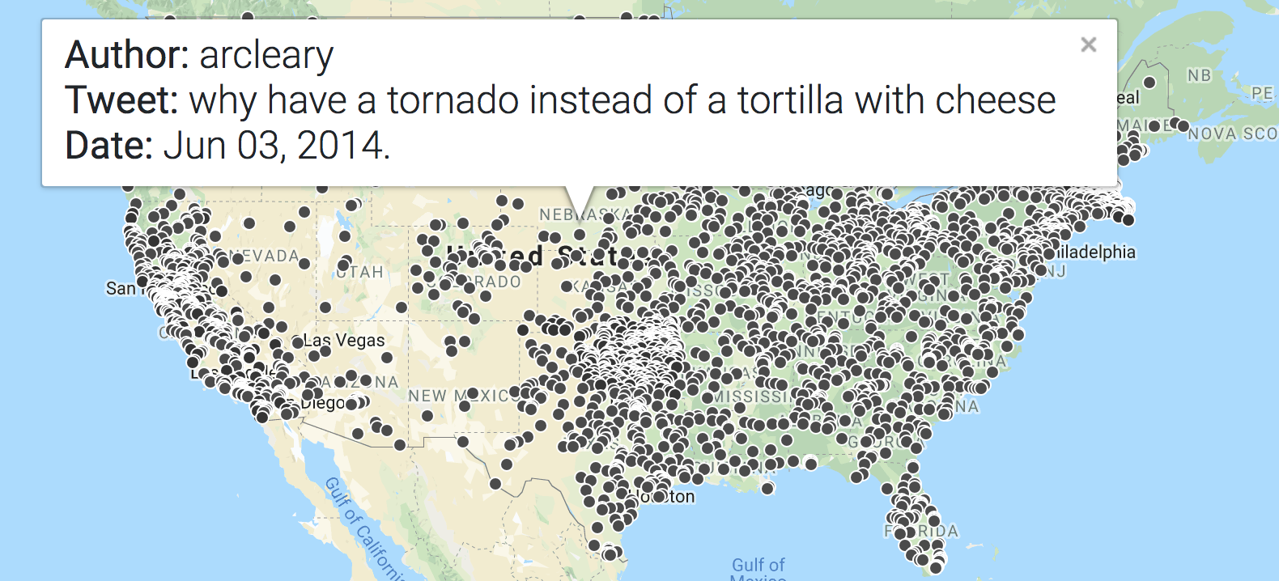
Motivation
Search results of spatio-temporal data are often displayed on a map or other visual interface
Displaying all results often result in a saturated and unreadable display.
This will prevents users’ investigation
Solution: Clustering the elements in UI (k-means)
Searching Natural Disasters
over Tweets

Slide 4
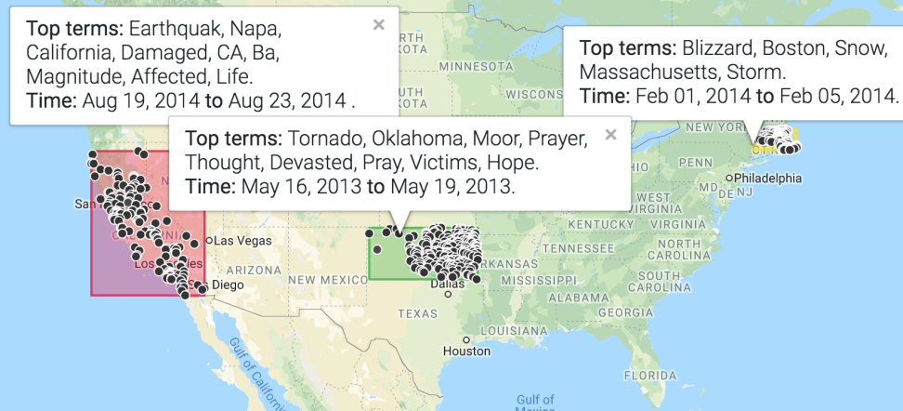
Why Clustering?
Elements in the same cluster behave similarly with respect to information needs – clustering hypothesis
By checking the cluster’s information, the user can get a clear overview of the elements in the cluster.

Slide 5
What’s wrong with k-means?
k-means doesn’t take into account relevance
Doesn’t guarantee to have highly relevant clusters
k-means requires the design of a complex distance metric
Combining time, location and keyword distances
Requires tuning
What value of k?
What distance metrics?

Slide 6
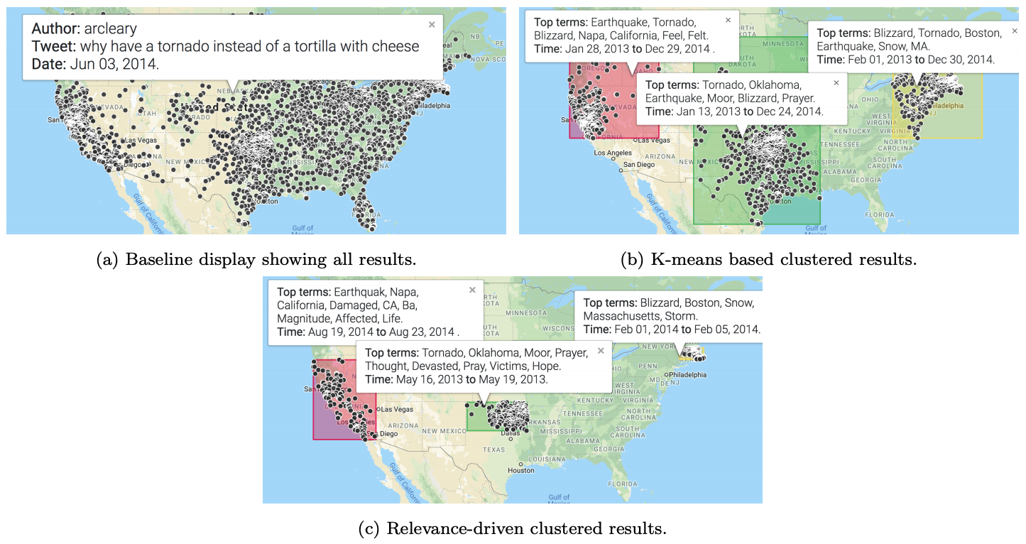
Why Relevance-driven Clustering?
We argue that it allows narrowing the clusters around relevant core events
Removes noisy elements that can be seen as irrelevant from an IR perspective

Slide 7
Outline
Motivation
Problem definition
Solution Framework
Offline experiment
User experiment
Conclusion

Slide 8
Problem Definition
Given a query and its visual display of matching results, how to build the best clusters under different constrains?
Question: How to build the best clusters under constrains?
Clustering should take relevance score into account, but how?
All elements have probabilistic score of relevance
Three constrains:
Time: defining time window of a cluster
Position: defining a geo-located bounding box of a cluster
Keyword: defining a set of keyword to include/exclude from a cluster

Slide 9
Problem Definition
What is a good cluster in this problem?
Good quality from IR respective – precision, recall and F1-score
Hence we keep the eye on Expected F1-Score of a cluster
Expected because we only have probability of relevance, not real labels
What is the mathematic definition of EF1?
0
0
0
high recall (trivial solution)
1
0
1
high F1-score (non - trivial)
0
1
0
high precision (trivial solution)

Slide 10


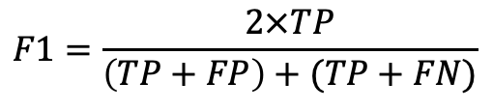
Problem Definition
Recall:
Each element contains two properties:
B(j) – relevance label (constant)
I(j) – whether this element in the cluster (unknown variable)
F1 definition:
EF1 definition:
S(j) – probabilistic relevant score of element j (constants)
Maximization of EF1 needs to be constrained, but how?
$$F1=\frac{2×TP}{\left(TP+FP\right)+(TP+FN)}$$
TP
No labels in real problem
P=TP+FP
TP+FN
explicit usage of relevant score

Slide 11
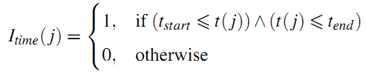
Problem Definition
EF1 maximization problem is constrained with three factors – time, position and keywords
Time constrains: a time-window tuple (t_{start} ,t_{end})

Slide 12
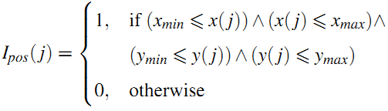

Problem Definition
Position constrains: a bounding-box tuple (x_{min}, x_{max}, y_{min}, y_{max})
Keyword constrains: a boolean value of term with global corpus size

Slide 13
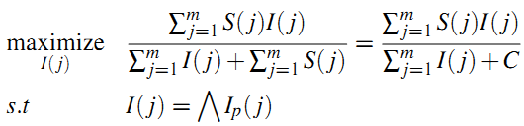
Problem Definition
Binary
Fractional MILP
Integer
Continuous

Slide 14
Outline
Motivation
Problem definition
Solution Framework
Offline experiment
User experiment
Conclusion

Slide 15
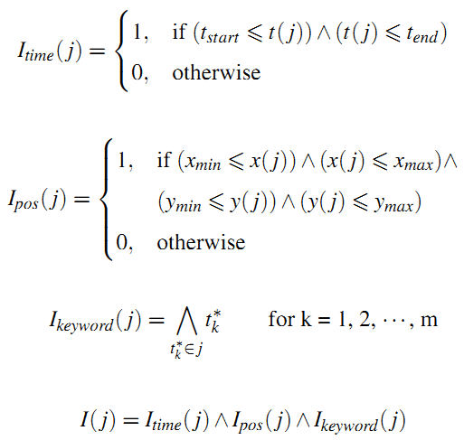
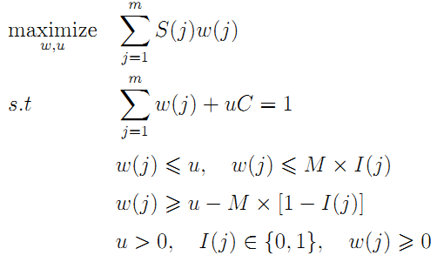

Solution Framework - MILP
Original EF1 definition: fractional MILP object (hard to solve)
Transform original EF1 into a MILP form: (Charnes-Cooper method and Glover linearization method)

Slide 16
Solution Framework
Our offline evaluation shows poor scalability of MILP method
We developed a greedy algorithm to solve this EF1-optimization problem.
Very efficient (scalable)
Good approximation of the optimal solution (MILP)

Slide 17
Solution Framework – Greedy Time
Binary partitioning search (BPS) in time domain with the Top-down manner
Alternatively search for t_{end} and t_{start}
Fixing t_{start}
t_{end}
Time
e₈
e₁
Ef1`
e₅
e₇
e₃
e₄
e₂
Ef1

Slide 18
Solution Framework – Greedy Time
Binary partitioning search (BPS) in time domain with the Top-down manner
Alternatively search for t_{end} and t_{start}
Fixing t_{end}
Time
e₈
e₁
e₅
e₇
e₃
e₄
e₂
Ef1`
Ef1
Ef1
t_{start}

Slide 19
Solution Framework – Greedy Position
The same BPS algorithm is able to be used in the position constrains.
Start with x-axis then y-axis.
Search sequence: X_{max}, X_{min}, Y_{max}, Y_{min}
y_{max}
X_{min}
y_{min}
X_{max}

Slide 20
Solution Framework – Greedy Keyword
Greedily build keywords set with a Top-down manner until convergence of EF1
keywords = {t₁, t₂, t₃, …, t_{m}}
Removing elements contains this term.
EF1⁽¹⁾
EF1⁽²⁾
EF1⁽³⁾
EF1^{(m)}

Slide 21
Solution Framework – Multiple Constrains
Previous method solves for the single natural constrain (time, or position, or keyword)… but how to handle multiple natural constrains?
Multiple constrains - based visual cluster:
greedily search with EF1 optimal among
Time (t_{start} ,t_{end}): EF1^{(T)}
Position (x_{min}, x_{max}, y_{min}, y_{max}): EF1^{(P)}
keywords set: EF1^{(K)}
EF1^{(T)} VS EF1^{(P)} VS EF1^{(K)}

Slide 22
Solution Framework – Multiple Clusters
Previous algorithm works for a single cluster… but how to build the sequential clusters?
1. set elements score as zero
2. re-create the cluster

Slide 23
Outline
Motivation
Problem definition
Solution Framework
Offline experiment
User experiment
Conclusion

Slide 24

Offline Experiment
Experimental steps:
Random selection of elements as relevant set
Scoring the elements based on relevance label (l)
Run the algorithm to get the best cluster
Measure the real F1-score in this cluster (NOT EF1)
r : random noisy
λ: noisy level
Small λ, high noisy

Slide 25
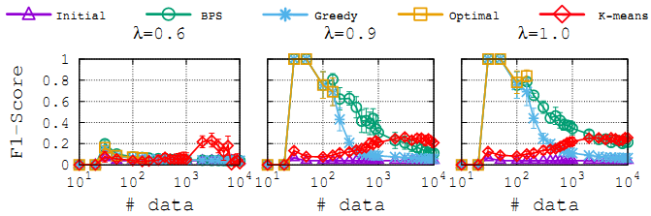
F1-Score performance: varying #data
Measuring different algorithms’ F1 performance with different size of data
BPS algorithm reaches a good approximation of the optimal solution (MILP).

Slide 26
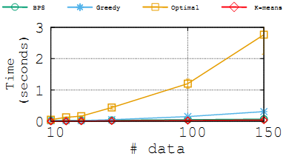
Time complexity: varying #data
Measuring different algorithms’ time with different size of data
BPS method has the lowest time complexity
MILP method is much higher than other methods
Lack of scalability in MILP method

Slide 27
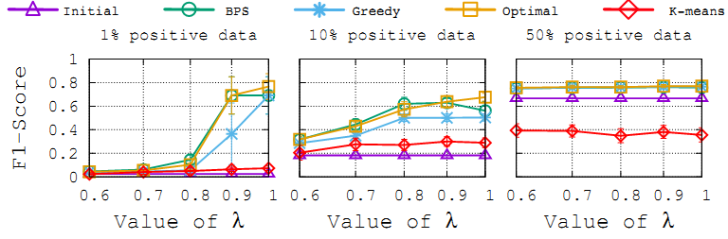
F1-Score performance: varying λ
Measuring different algorithms’ F1 performance with different λ
BPS still reaches a good approximation of the optimal solution.

Slide 28
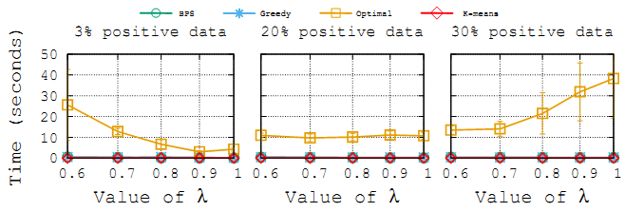
Time complexity: varying λ
Measuring different algorithms’ time with different λ
MILP method is the highest time complexity (no scalability)

Slide 29
Outline
Motivation
Problem definition
Solution Framework
Offline experiment
User experiment
Conclusion

Slide 30
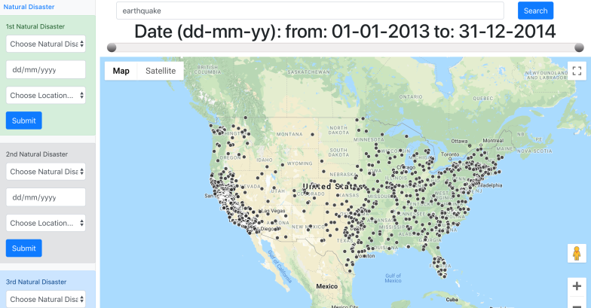

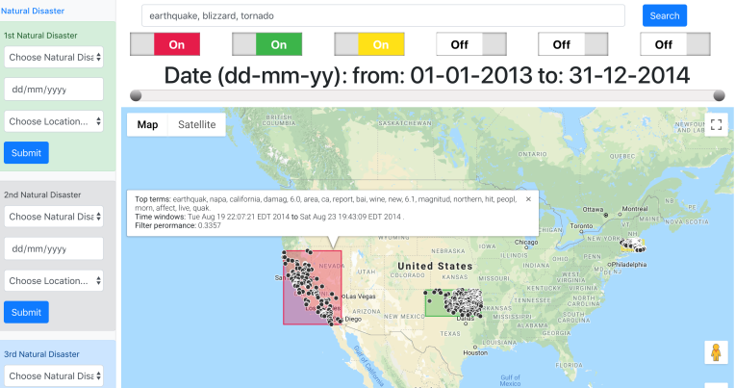
User Experiment – algorithms evaluation
Each user interacts with three different systems
In each system, each user would query the system to achieve three search tasks
User’s answers in each task: natural disaster type, time, and location
Baseline system – No clustering
Clustering system – k-means & BPS

Slide 31
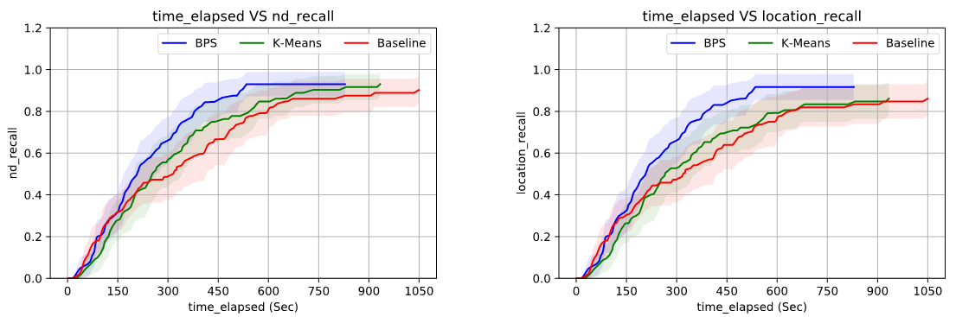
User Experimental result - recall
BPS achieves the best performance of recall.
BPS system cost much less time than other algorithms.

Slide 32
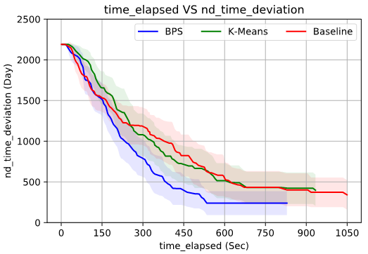
User Experimental result – time deviation
BPS create the least asymptotic time error with some temporally clusters

Slide 33
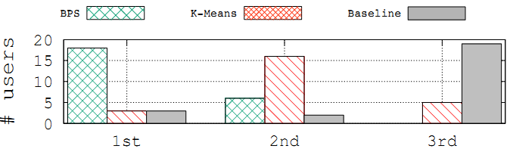
Survey about users’ preference
Previous analysis is about users’ performance. How about their preference ?
75% of users have highest preference in the BPS system

Slide 34
Outline
Motivation
Problem definition
Solution Framework
Offline experiment
User experiment
Conclusion

Slide 35
Conclusion
A novel relevance – driven clustering framework for interactive visual search
Reformulating the EF1 optimization problem into MILP form
Two greedy strategies to solve this optimization problem
An offline evaluation of the algorithms
BPS clustering achieves a good approximation of the optimal solution.
BPS greedy algorithms is very scalable and robust
A user study with 24 participants
Greedy-driven system (BPS) has the best performance
75% of users have highest preference in the BPS system

Slide 36
Thanks for your attentions Any Questions?

Slide 37
Aside – Information Retrieval metrics
Global element set
Ideally, A = B
Relevant set (B)
B(j) = 1, if j∈B
Retrieval set (A)
Retrieval set (A)
I(j) = 1, if j∈A
Relevant set (B)
Precision: P = |C| / |A|
Recall: R = |C| / |B|
F1-score: F1= 2*P*R/(P + R)
C = A∩B

